Slide 1


Slide 2
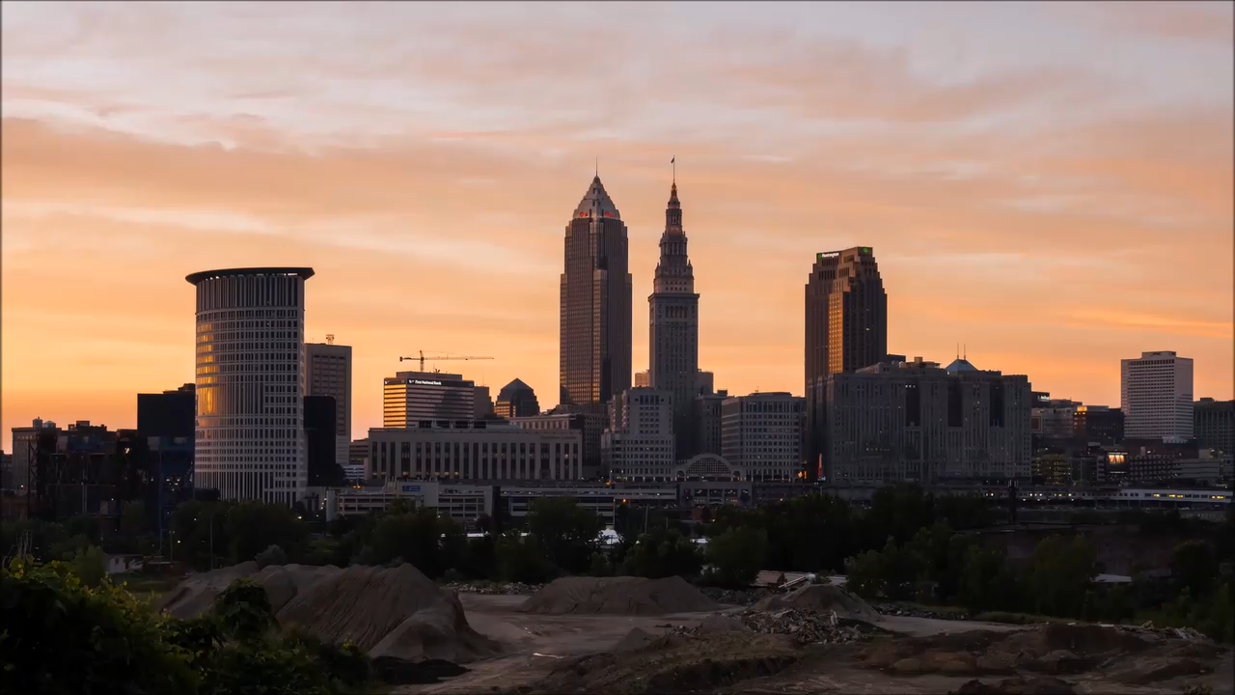

Slide 3



oraCLE
Team Cowboy Bebop | Project {oraCLE}
The Earth and Us: Live Smart
Application of Data to Settlement Planning
Team: Laimis Belzinskas, Benjamin Cool-Fergus, Eugene Malinskiy, Ilya Malinskiy, Jason Mancuso, Kaitie Fox

Slide 4
Yes Cleveland, Seriously
Access to Lake Erie, and Great Lakes
Fresh water, climate stabilization, fishery, trade
Stable, known weather
Stable, known geology
Extensively developed trade & transportation network
#216
#thisisCLE

Slide 5
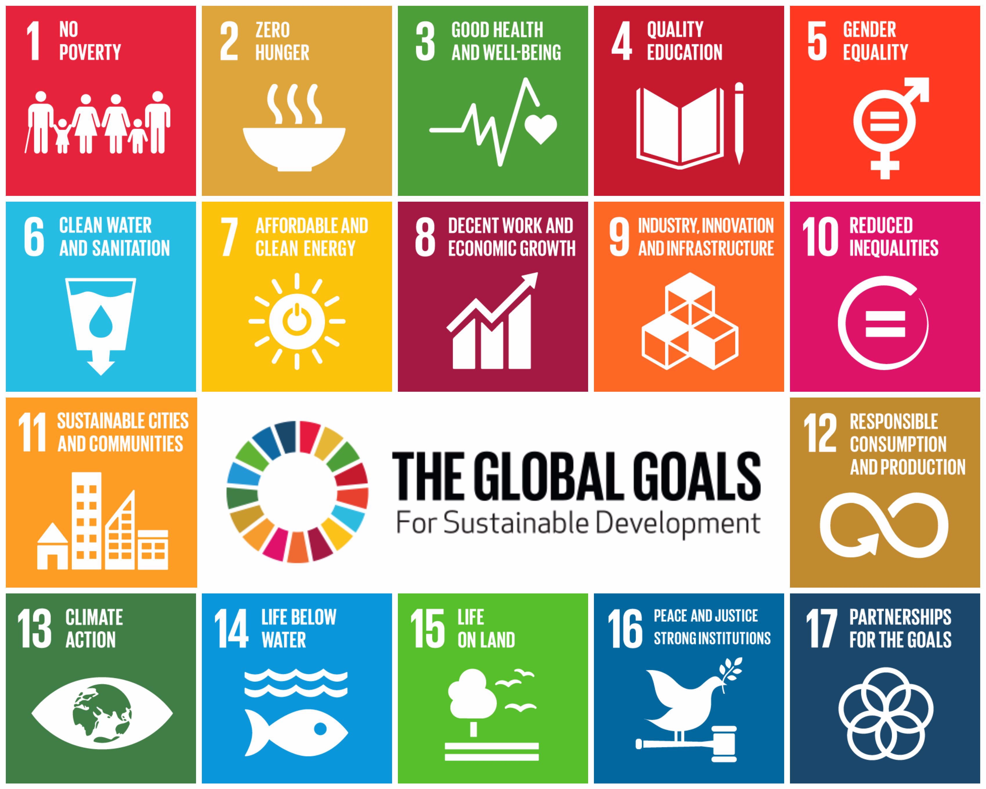

Slide 6


Slide 7
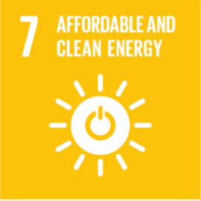
The Future of CLE
Energy – The Crux of Everything
Affordable, clean, renewable energy is central to, and informs all other sustainable development goals
Ohio current power distribution (2016):
We need to transition!
Smart grid needs to be developed
By 2030 Meeting the UN Sustainable Development Goals
Becoming the city of the future
Independently sustainable, fully self-provisional
Path to get there is via clean energy, advanced/smart infrastructure, and cutting edge food production

Slide 8
Wind Farms
2 million people in the Greater Cleveland Area
Cleveland GDP is $134 million
Requires ~3,500 2MW Turbines
$4 million/turbine
$14 billion for all turbines
~$1 billion a year
Investing less than 1% of Cleveland GDP a year would build us the wind farms by 2030
The US currently invests around $14 billion annually in wind energy

Slide 9
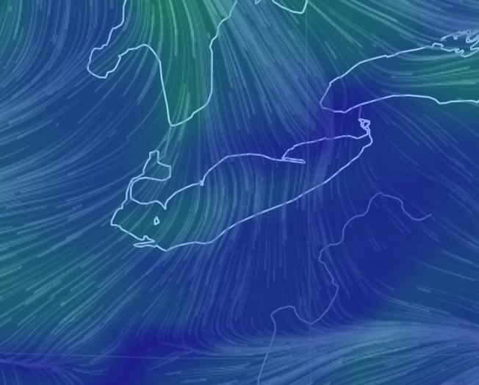
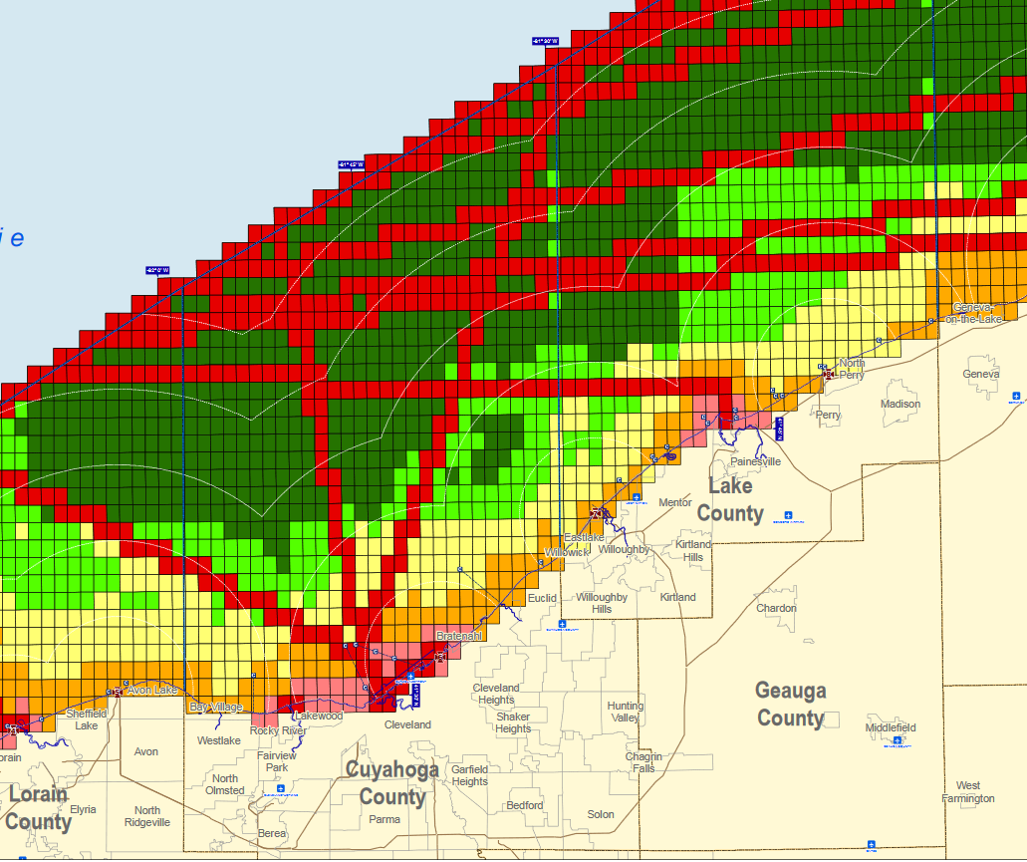
Wind Location

Slide 10
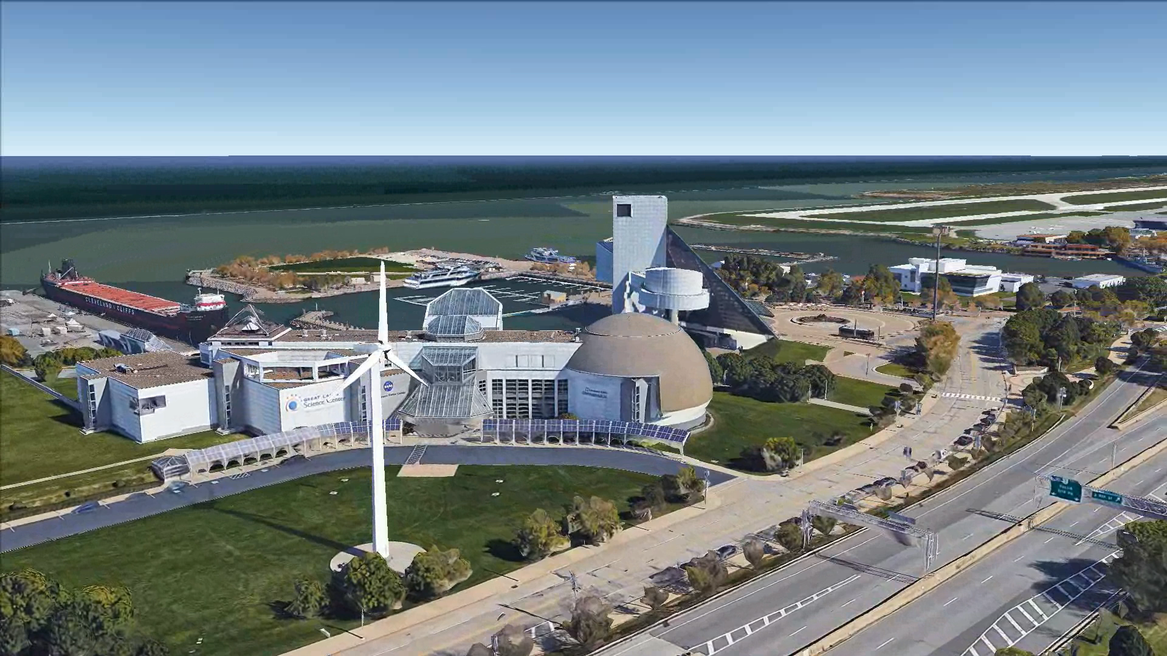

Slide 11
Supplemental Energy Production
Solar
Inexpensive, and can be placed on many buildings and rooftops in the city
We don’t have the best weather and sunlight amounts in Cleveland
Nuclear
A huge amount of base load power available
No one wants one in their backyard
Continued uncertainty around used fissile material disposal

Slide 12
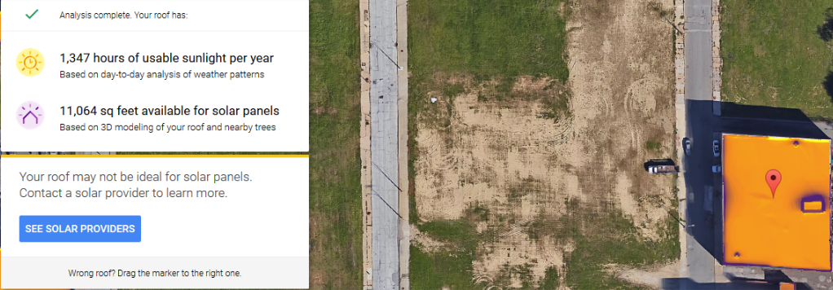
Solar Location
An 11,064 sq. foot roof will provide ~241,332 kWh per Year (~$28,645)

Slide 13
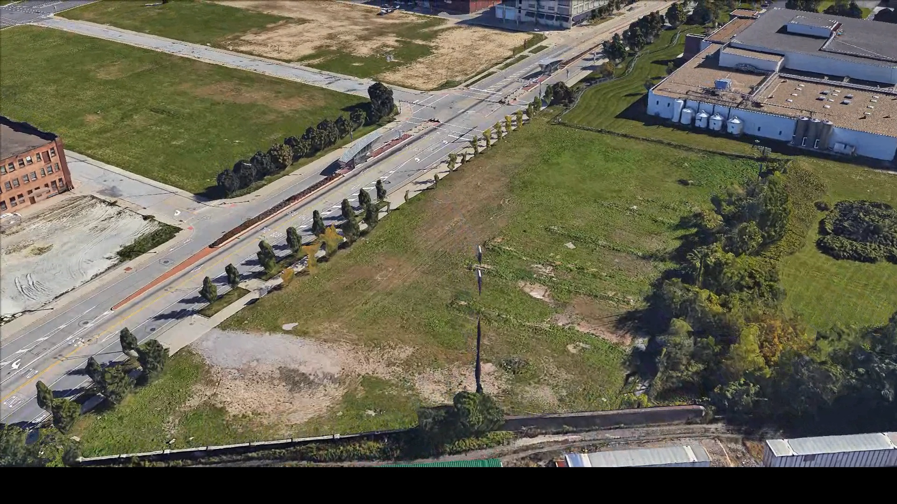


Slide 14
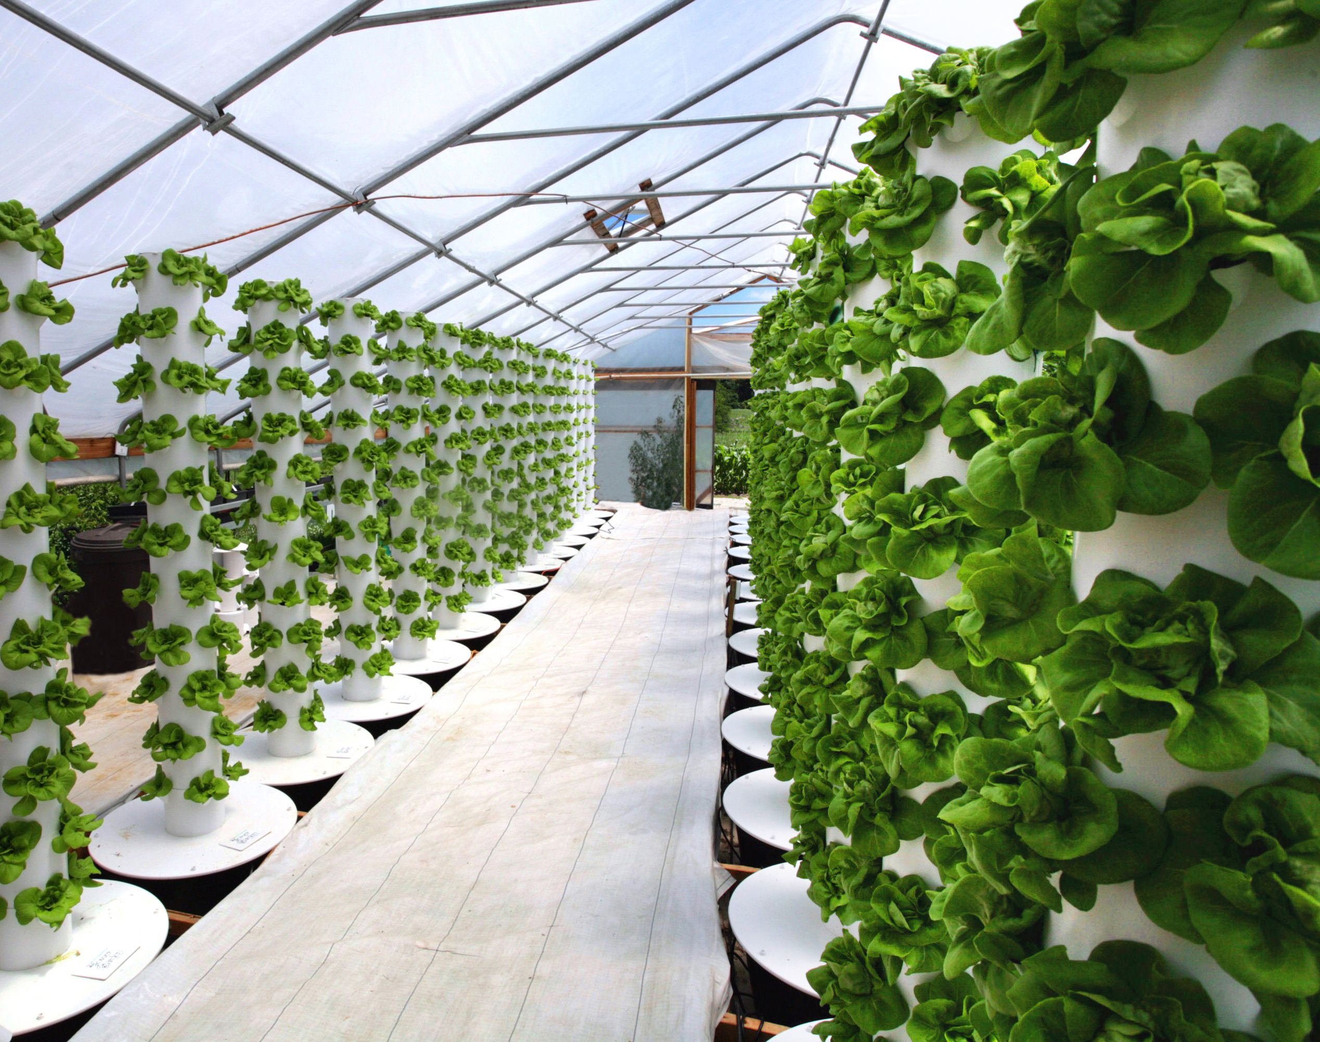
Vertical Farming – Food Sustainability

Slide 15
Greenhouse Urban Cle
Start up costs depend on size, access to sunlight, energy source
Water circulation
Cooling
LEDs
Equipment
Labor costs
One estimation for brand new facility ~$100 million
The Plant in Chicago: $1.7 million in grant
4-storey reclaimed building

Slide 16
Opportunity and Efficiency
Vertical Farms operating typically for-profit
Recommend government subsidy to encourage vertical farming endeavors
Like grant in Chicago, The Plant
Anticipates rapid urbanization
Double output per square foot
Cleaning cities

Slide 17
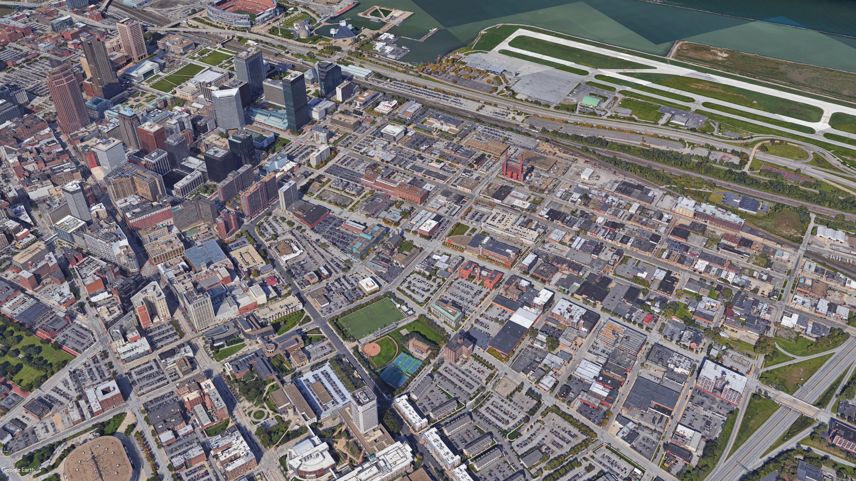

Slide 18
Options!

Slide 19
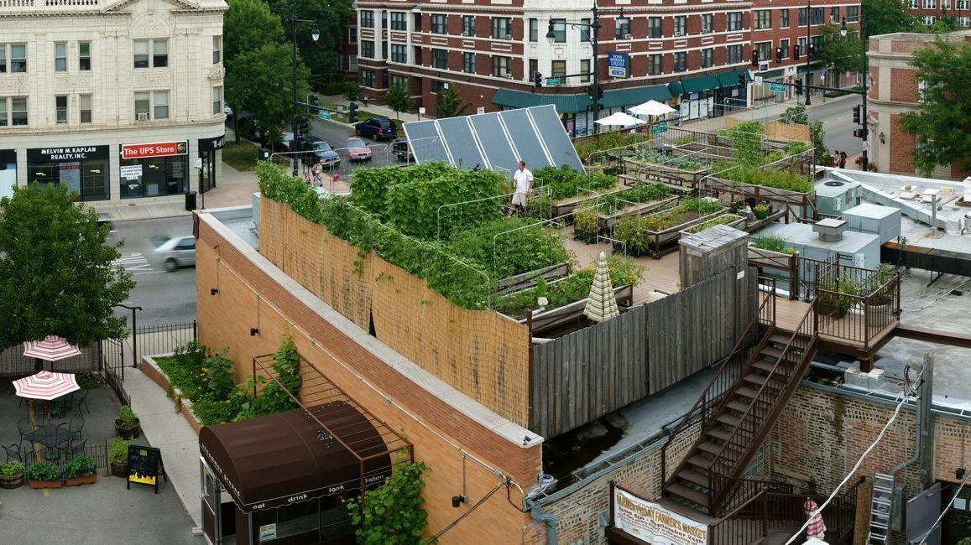

Slide 20
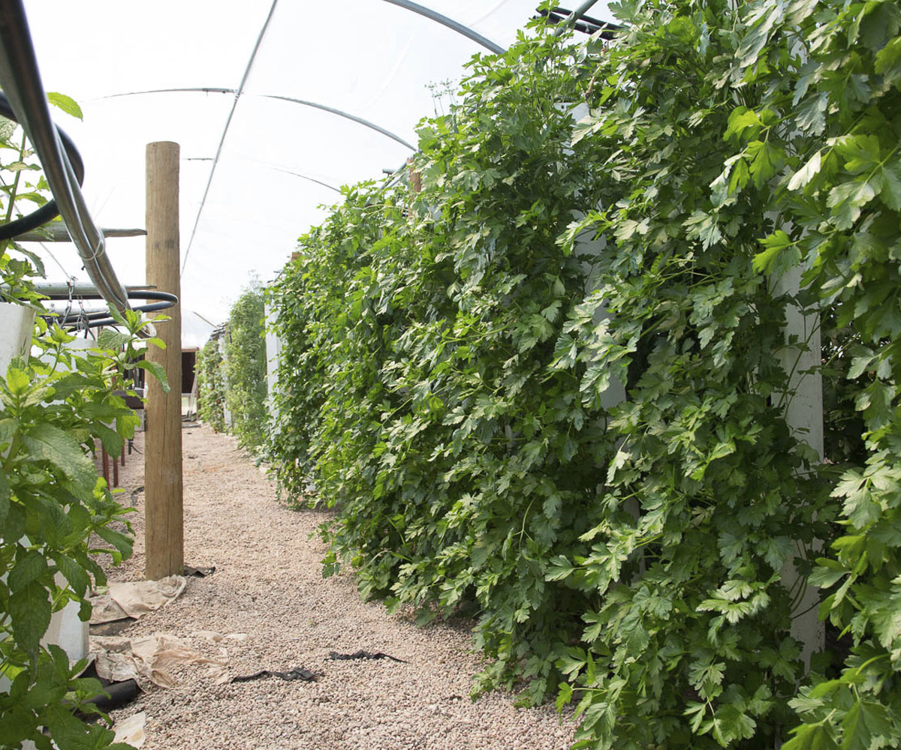

Slide 21
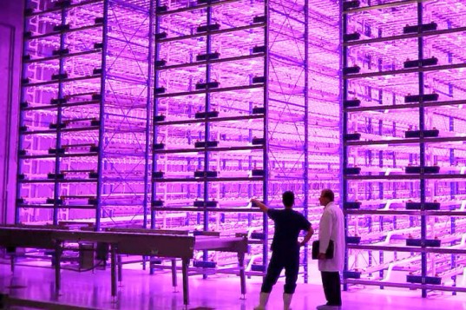

Slide 22
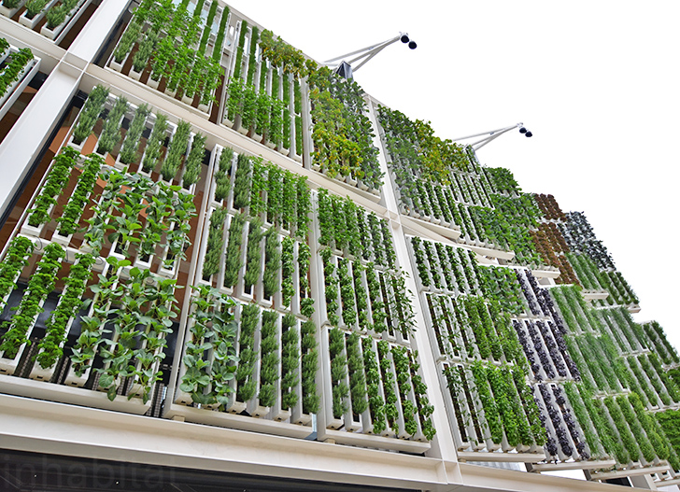

Slide 23

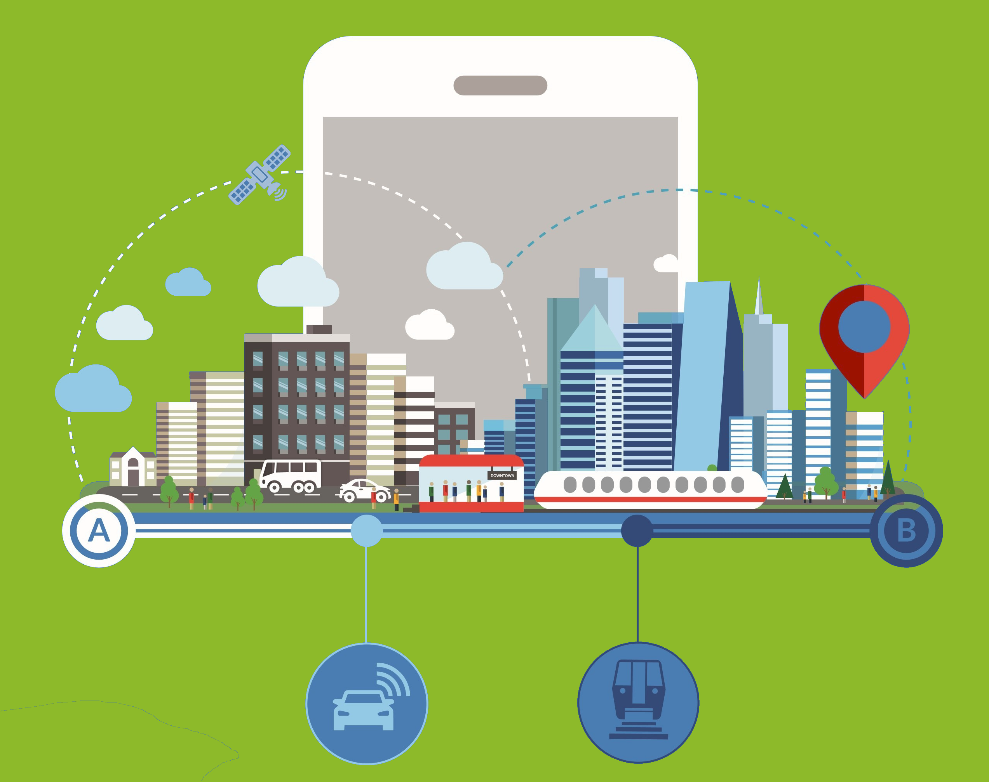
Transportation Model
The development of:
A safe cycling network
A frequent bus grid
Traffic calming
Parking management
Provides
Safety
Sustainability
Integration
Provide the world’s first Mobility-as-a-Service (MaaS) pass/platform

Slide 24

The Future of CLE - IMPACT
Thank You
This will completely change Cleveland over the next two decades!
Will bring innovation, wealth, and equality
Sustainability and self-reliance

Slide 25
References
http://pvwatts.nrel.gov/pvwatts.php
https://www.google.com/sunroof
http://www.undp.org/content/undp/en/home/sustainable-development-goals.html
http://web.mit.edu/nature/projects_12/pdfs/Yarina_RepurposedVerticalFarms.pdf
http://plantchicago.org/
https://earth.nullschool.net/
https://conaquaponics.blogspot.com/2016/08/hydroponic-gardening-at-disney-epcot.html
http://thephotogardenbee.com/2010/01/05/aeroponics-gardens-at-epcot-part-iii-the-land/
http://architek.com/products/vertical-gardens
https://www.puco.ohio.gov/be-informed/consumer-topics/how-does-ohio-generate-electricity/
http://libraryresources.unog.ch/sdgs
http://sustainablecities.org.nz/wp-content/uploads/Martinot_CSC_Sep12_pt2.pdf
http://www.leedco.org/resources/links-resources
http://www.indiatimes.com/news/india/bengaluru-gets-its-1st-vertical-garden-to-curb-pollution-it-already-has-over-3-500-plants-273733.html

